Slide 1
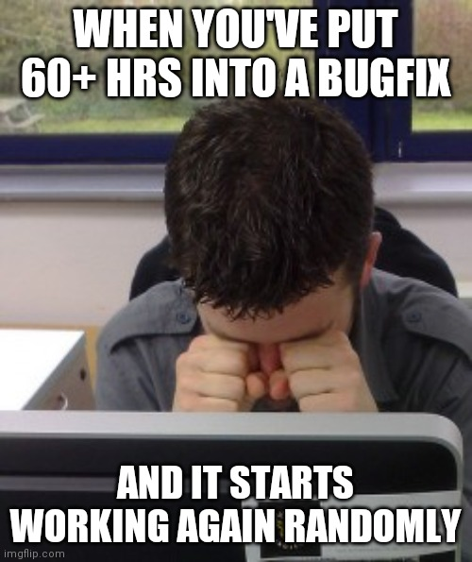

Slide 2
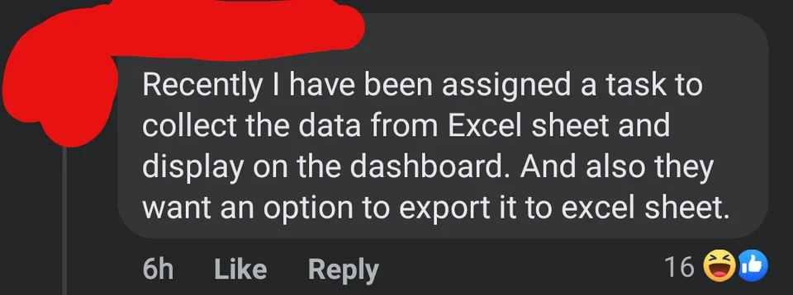

Slide 3


Slide 4

1. Creating Output
2. Variables
3. If Statements
4. Loops
5. Functions

Slide 5


Slide 6
1. For Loops

Slide 7
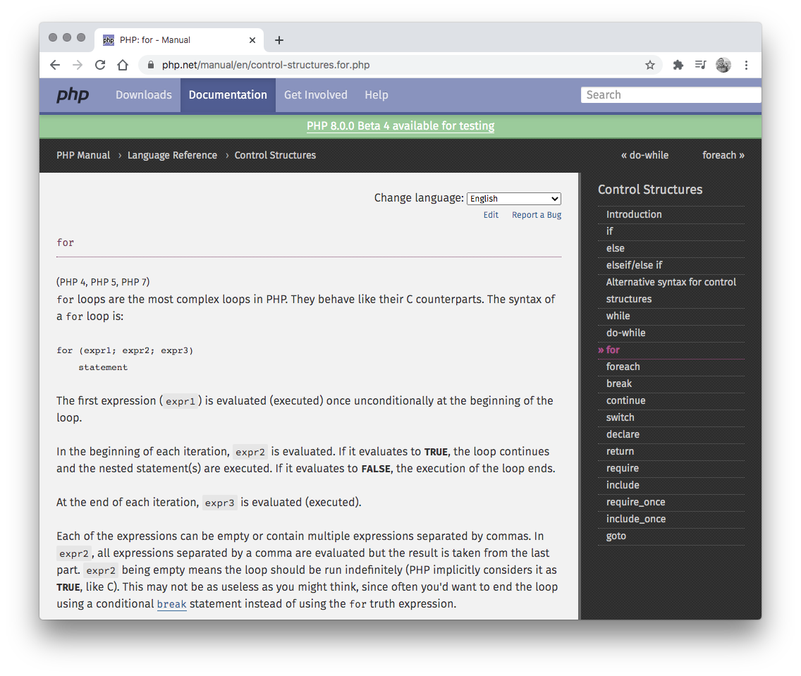
For Loops
PHP uses for loops to repeat a block of code a set number of times:
<?php for ($x = 0; $x <= 10; $x++) { echo "The number is: $x <br>"; } ?>

Slide 8
For Loops
Statement 1: is executed before the loop (the code block) starts.
Statement 2: defines the condition for running the loop (the code block).
Statement 3: is executed each time after the loop (the code block) has been executed.
<?php for (init counter; test counter; increment counter) { // code to be executed } ?>

Slide 9


Slide 10
Example Loop Exercise
Use a for loop to achieve the following:
Repeat 40 times and displays the numbers 1 to 40 on seperate lines (the numbers should be black)
Every fifth number is red (5, 10, 15, etc…)
Every fourth number is blue (4, 8, 12, etc…)
When the fourth and fifth number overlap, the number is purple (20, 40)

Slide 11
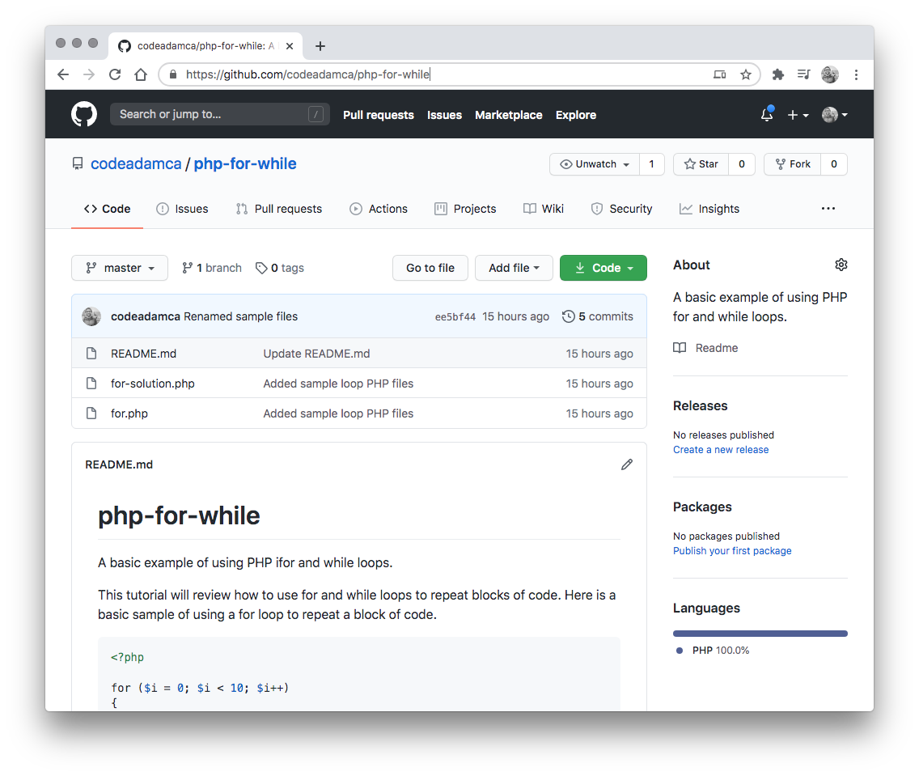
PHP For/While Exercise
Follow the output exercise on GitHub:
https://github.com/codeadamca/php-for-while

Slide 12
Goals this Week
1. Understand how to use for loops 2. Continue working on the first PHP exercise

